Slide 1
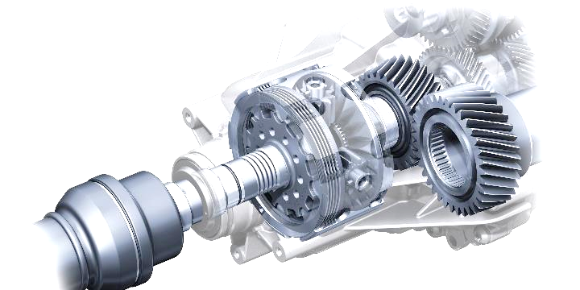
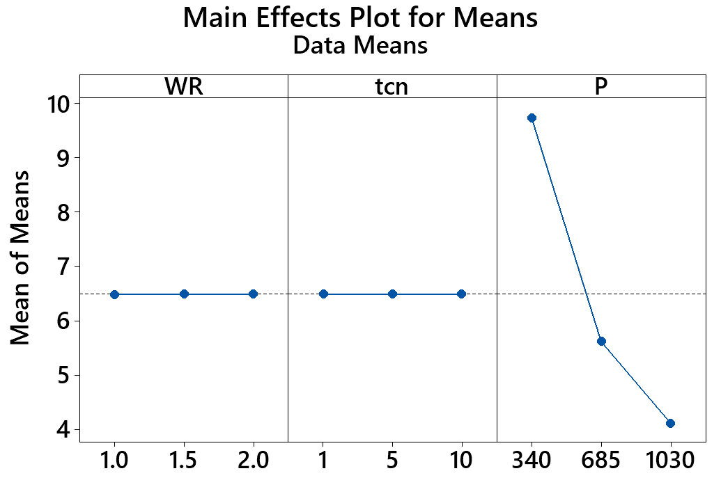
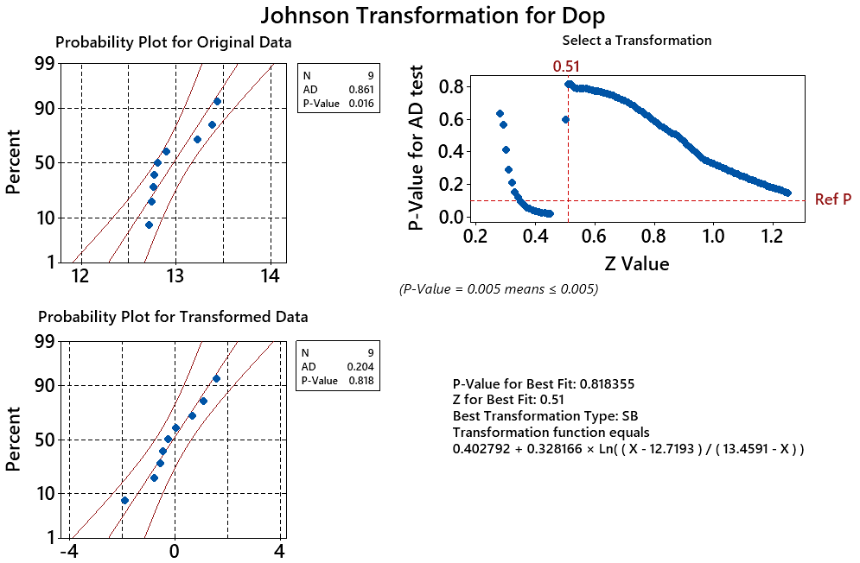
Studying the Impacts of Process Parameters on the Cost of Blasting Process
Using Boron Carbide Nozzle
Le Hoang Anh^{1,a}, Nguyen Dinh Ngoc^{2,b}, Nguyen Huu Quang^{3,c}, Nguyen Anh Tuan^{3,d}, Trinh Kieu Tuan^{3,e},
Tran Ngoc Huy Thinh^{4,f}, Tran Ngoc Giang^{2,g}, and Vu Ngoc Pi^{2,*}
¹Vinh Long University of Technology Education, Vietnam
²Thai Nguyen University of Technology, Vietnam
³University of Economics - Technology for Industries, Vietnam
⁴Nguyen Tat Thanh University, Vietnam
ªanhlh@vlute.edu.vn, ^{b}ngocnd@tnut.edu.vn, ^{c}nhquang@uneti.edu.vn, ^{d}Natuan.ck@uneti.edu.vn, ^{e}tktuan.ck@uneti.edu.vn, ^{f}tnhthinh@ntt.edu.vn, ^{g}tranngocgiang@tnut.edu.vn
*Corresponding author: vungocpi@tnut.edu.vn
Introduction
Results and discussion
In this study, the nozzle wear rate per hour, the time for changing a nozzle, the compressive power were chosen as the input parameters to optimize for finding the maximum nozzle lifetime as well as the minimum cleaning cost. A screening experiment is developed. The results show that the compressive power has the dominant effect on the cleaning cost, while two remaining process parameters have minor impacts on the response. The cleaning cost maximizes of 4.108 USD/m2 at the nozzle wear rate per hour of 10-3 mm/h, the time for changing a nozzle of 10 min, and the compressive power of 1030 kW.
.
Table 3. Analysis of variance of mean cleaning cost.
Figure 1. The impacts of process parameters on mean cleaning cost.
Source | DF | Seq SS | Adj SS | Adj MS | F | P
WR | 2 | 0.0001 | 0.0001 | 0.0001 | 49.27 | 0.020
t_{cn} | 2 | 0.0000 | 0.0000 | 0.0000 | 11.33 | 0.081
P | 2 | 51.0182 | 51.0182 | 25.5091 | 22171528.86 | 0.000
Residual Error | 2 | 0.0000 | 0.0000 | 0.0000
Total | 8 | 51.0183
Experimental procedure
Figure 2. Johnson transformation between two set data of D_{op}.
Table 1. Input parameters and levels.
Factor | Code | Unit | Level 1 | Level 2 | Level 3
Nozzle wear rate per hour | WR | 10⁻³ mm/h | 1 | 1.5 | 2
Time for changing a nozzle |  | min. | 1 | 5 | 10
Compressure power |  | kW | 340 | 685 | 1030
Table 2. Plan of tests designed by Taguchi L9 (3^3).
No | WR | t_{cn} | P_{c} | d_{op} [mm] | C_{cl} [USD/m²) | S/N
1 | 1 | 1 | 340 | 13.230 | 9.736 | -19.7674
2 | 1 | 5 | 685 | 12.770 | 5.609 | -14.9782
3 | 1 | 10 | 1030 | 12.720 | 4.108 | -12.2724
4 | 1.5 | 1 | 685 | 12.810 | 5.613 | -14.9835
5 | 1.5 | 5 | 1030 | 12.740 | 4.110 | -12.2771
6 | 1.5 | 10 | 340 | 13.380 | 9.743 | -19.7741
7 | 2 | 1 | 1030 | 12.760 | 4.111 | -12.2798
8 | 2 | 5 | 340 | 13.440 | 9.746 | -19.7768
9 | 2 | 10 | 685 | 12.900 | 5.621 | -14.9968
Conclusions
Optimization process to find the minimum cleaning cost for the abrasive blasting system with a boron carbide nozzle is presented in this study. Three main process parameters including the nozzle wear rate per hour, the time for changing a nozzle, the compressive power are selected to investigate their impacts on the responses, maximum lifetime of nozzle. The following conclusions can be made:
- Compressive power has dominant effect on the cleaning cost, while two remaining process parameters have minor impacts on the response.
- The cleaning cost minimizes at 4.108 USD/m² when the wear rate per hour is 10⁻³ mm/h, the time for changing a nozzle is 10 min, and the compressive power is 1030 kW.
- The transferred data by using Johnson transformation are well fitted to normal distribution. These P-values are more important to significant level of 0.05 when theirs values are D_{op} of 0.818 and C_{cl} of 0.634.
Acknowledgments: The work described in this paper was supported by Thai Nguyen University of Technology for a scientific project.

