Slide 1
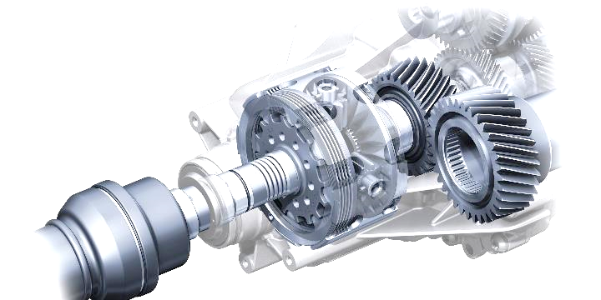
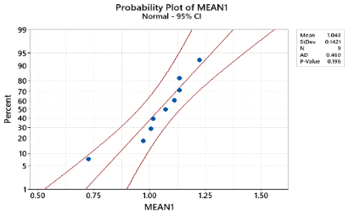
Impacts of Dressing Parameters on Material Removal Rate when Conducting Internal Grinding of Hardened SKD11 Steel
Trinh Kieu Tuan^{1,a}, Le Xuan Hung^{2,b}, Nguyen Dinh Ngoc^{2,d}, Dang Quoc Cuong^{3,c}, Nguyen Huu Quang^{1, e}, Le Hoang Anh^{4,f}, Tran Ngoc Giang^{2,g}, and Vu Ngoc Pi^{2,*}
¹University of Economics - Technology for Industries, Vietnam
²Thai Nguyen University of Technology, Vietnam
³Nguyen Tat Thanh University, Vietnam
⁴Vinh Long University of Technology Education, Vietnam
ªtktuan@uneti.edu.vn, ^{b}lexunahung@tnut.edu.vn, ^{c}ngocnd@tnut.edu.vn ^{d}dqcuong@ntt.edu.vn, ^{e}nhquang@uneti.edu.vn, ^{f}anhlh@vlute.edu.vn ^{g}tranngocgiang@tnut.edu.vn
*Corresponding author: vungocpi@tnut.edu.vn
Introduction
Results and discussion
This study aims to optimize the internal grinding process of hardened SKD11 steel to find the optimum set of dressing parameters that can maximize material removal rate. The input parameters used are Coarse dressing depth, Number of coarse dressing, Fine dressing depth, Number of Fine dressing, Non-feeding dressing, and Dressing feed speed. Moreover, the consistency between the predictions and experiments is confirmed by the Anderson-Darling checking method.
.
Level | n_{c} | a_{f} | n_{f} | n₀ | a_{c} | S_{d}
1 | 0.3810 | 1.6004 | 1.2269 | 1.0754 | 1.3997 | 1.4414
2 | 1.7873 | 1.7983 | 1.2138 | 1.4939 | 1.7102 | 1.6685
3 | 2.4643 | 1.3808 | 2.0625 | 1.7909
4 | 1.5872 | 1.4403 | 1.7167 | 1.8597
Delta | 2.0833 | 0.4176 | 0.8487 | 0.7843 | 0.3105 | 0.2270
Rank | 1 | 4 | 2 | 3 | 5 | 6
Experimental procedure
Table 3. Influential level of dressing parameters on MRR.
Dressing parameters | Denoting | Optimum levels | Optimum values
Number of coarse dressing | n_{c} | 3 | 3
Coarse dressing depth (mm) | a_{c} | 2 | 0.03
Number of fine dressing | n_{f} | 3 | 2
Fine dressing depth (mm) | a_{f} | 2 | 0.01
Non-feeding dressing | n₀ | 4 | 3
Feed speed (m/min) | S_{d} | 2 | 1.2
Table 1. Input parameters and levels.
Input parameters | Denoting | Levels
 |  | 1 | 2 | 3 | 4
Coarse dressing depth (mm) | a_{c} | 0.025 | 0.03
Number of coarse dressing | n_{c} | 1 | 2 | 3 | 4
Fine dressing depth (mm) | a_{f} | 0.005 | 0.01 | 0.015 | 0.02
Number of Fine dressing | n_{f} | 0 | 1 | 2 | 3
Non-feeding dressing | n₀ | 0 | 1 | 2 | 3
Feed speed (m/min) | S_{d} | 1 | 1.2 | - | -
Table 4. The optimum set of dressing parameters.
Table 2. The obtained experimental results for surface roughness
No. | n_{c} | a_{f} | n_{f} | n₀ | a_{c} | S_{d} | MRR |  |  | Mean | S/N
 |  |  |  |  |  |  | Trial 1 | Trial 2 | Trial 3
1 | 1 | 0.005 | 0 | 0 | 0.025 | 1.0 | 0.919 | 0.922 | 0.915 | 0.9186 | -.7372
2 | 1 | 0.010 | 1 | 1 | 0.030 | 1.0 | 1.035 | 1.040 | 1.049 | 1.0413 | 0.3511
3 | 1 | 0.015 | 2 | 2 | 0.025 | 1.2 | 1.117 | 1.122 | 1.125 | 1.1215 | 0.9958
4 | 1 | 0.020 | 3 | 3 | 0.030 | 1.2 | 1.102 | 1.114 | 1.117 | 1.1111 | 0.9143
5 | 2 | 0.005 | 1 | 2 | 0.030 | 1.2 | 1.248 | 1.252 | 1.238 | 1.2459 | 1.9091
6 | 2 | 0.010 | 0 | 3 | 0.025 | 1.2 | 1.275 | 1.265 | 1.260 | 1.2667 | 2.0528
7 | 2 | 0.015 | 3 | 0 | 0.030 | 1.0 | 1.174 | 1.182 | 1.179 | 1.1782 | 1.4244
8 | 2 | 0.020 | 2 | 1 | 0.025 | 1.0 | 1.219 | 1.230 | 1.226 | 1.2251 | 1.7630
9 | 3 | 0.005 | 2 | 3 | 0.030 | 1.0 | 1.488 | 1.492 | 1.484 | 1.4878 | 3.4510
10 | 3 | 0.010 | 3 | 2 | 0.025 | 1.0 | 1.366 | 1.372 | 1.379 | 1.3724 | 2.7494
11 | 3 | 0.015 | 0 | 1 | 0.030 | 1.2 | 1.268 | 1.275 | 1.270 | 1.2709 | 2.0825
12 | 3 | 0.020 | 1 | 0 | 0.025 | 1.2 | 1.193 | 1.195 | 1.208 | 1.1988 | 1.5744
13 | 4 | 0.005 | 3 | 1 | 0.025 | 1.2 | 1.227 | 1.220 | 1.235 | 1.2273 | 1.7788
14 | 4 | 0.010 | 2 | 0 | 0.030 | 1.2 | 1.268 | 1.264 | 1.262 | 1.2647 | 2.0400
15 | 4 | 0.015 | 1 | 3 | 0.025 | 1.0 | 1.124 | 1.129 | 1.121 | 1.1247 | 1.0204
16 | 4 | 0.020 | 0 | 2 | 0.030 | 1.0 | 1.183 | 1.189 | 1.198 | 1.1898 | 1.5094
Figure 1. Main Effects Plot for S/N ratio on MRR.
Figure 2. Probility graph of accordance of proposed model with MRR.
Conclusions
This study presents optimizing dressing parameters set which can maximize MRR of hardened SKD 11. Taguchi method is used to design the experiments. ANOVA is applied to find the significance of each input parameter on the response. The reliability of the proposed method is confirmed by experiments which is carried out by optimum set of dressing parameters. Following conclusions can be made:
- The number of coarse dressing is the factor with the greatest influence on MRR(65.83%), however, coarse dressing depth and dressing feed speed slitghtly impact on MRR (2.81% and 1.5%, respectively).
- The optimum value of material removal rate is 1.51417mm3/s when using the optimum dressing parameters.
- The checking method of Anderson-Darling shows the coincidence of proposed model and experiments with P-value of 0.422 at significant level of 95%.
Acknowledgments: The work described in this paper was supported by Thai Nguyen University of Technology for a scientific project.

